Slide 1
Software Quality Engineering
Lecture 1
software testing
Alina Arshad
alina.arshad@nu.edu.pk

Slide 2
DECISION TABLE BASED TESTING
In Software Engineering, boundary value and equivalent partition are other similar techniques used to ensure better coverage.
However, in a system where for each set of input values the system behavior is different, boundary value and equivalent partitioning technique are not effective in ensuring good test coverage.
In this case, decision table testing is a good option. This technique can make sure of good coverage, and the representation is simple so that it is easy to interpret and use.

Slide 3
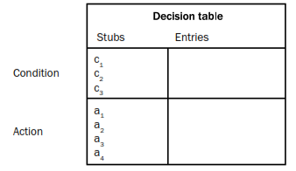
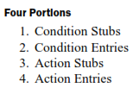
DECISION TABLE BASED TESTING
Decision tables are used in many engineering disciplines to represent complex logical relationships.
An output may be dependent on many input conditions and decision tables give a pictorial view of various combinations of input conditions.
There are four portions of the decision table. The decision table provides a set of conditions and their corresponding actions.

Slide 4
Parts of the Decision Table
The four parts of the decision table are given as:
Condition Stubs: All the conditions are represented in this upper left section of the decision table. These conditions are used to determine a particular action or set of actions.
Action Stubs: All possible actions are listed in this lower left portion of the decision table.
Condition Entries: In the condition entries portion of the decision table, we have a number of columns and each column represents a rule.
Action Entries: Each entry in the action entries portion has some associated action or set of actions in this lower right portion of the table.

Slide 5
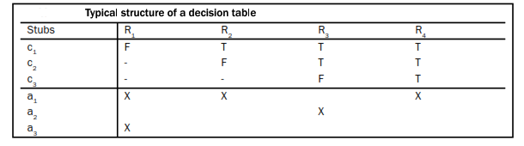
Typical structure of decision table

Slide 6
decision table for a login screen.
The condition is simple if the user provides correct username and password the user will be redirected to the homepage. If any of the input is wrong, an error message will be displayed.
Case 1 – Username and password both were wrong. The user is shown an error message.
Case 2 – Username was correct, but the password was wrong. The user is shown an error message.
Case 3 – Username was wrong, but the password was correct. The user is shown an error message.
Case 4 – Username and password both were correct, and the user navigated to homepage

Slide 7
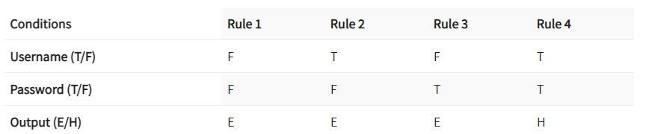
Notes:
Activity : any example of decision table

Slide 8
applicability
Decision tables are popular in circumstances where an output is dependent on many conditions and a large number of decisions are required to be taken.
They may also incorporate complex business rules and use them to design test cases.
Every column of the decision table generates a test case.
As the size of the program increases, handling of decision tables becomes difficult and cumbersome.
In practice, they can be applied easily at unit level only. System testing and integration testing may not find its effective applications.

Slide 9
applicability
It's a tabular representation of input conditions and resulting actions. Additionally, it shows the causes and effects. Therefore, this technique is also called a cause-effect table.
Testing combinations can be a challenge, especially if the number of combinations is enormous. Moreover, testing all combinations is not practically feasible as it's not cost and time effective. Therefore, we have to be satisfied with testing just a small subset of combinations. That is to say, the success of this technique depends on our choice of combinations

Slide 10
Any question????

